Slide 1
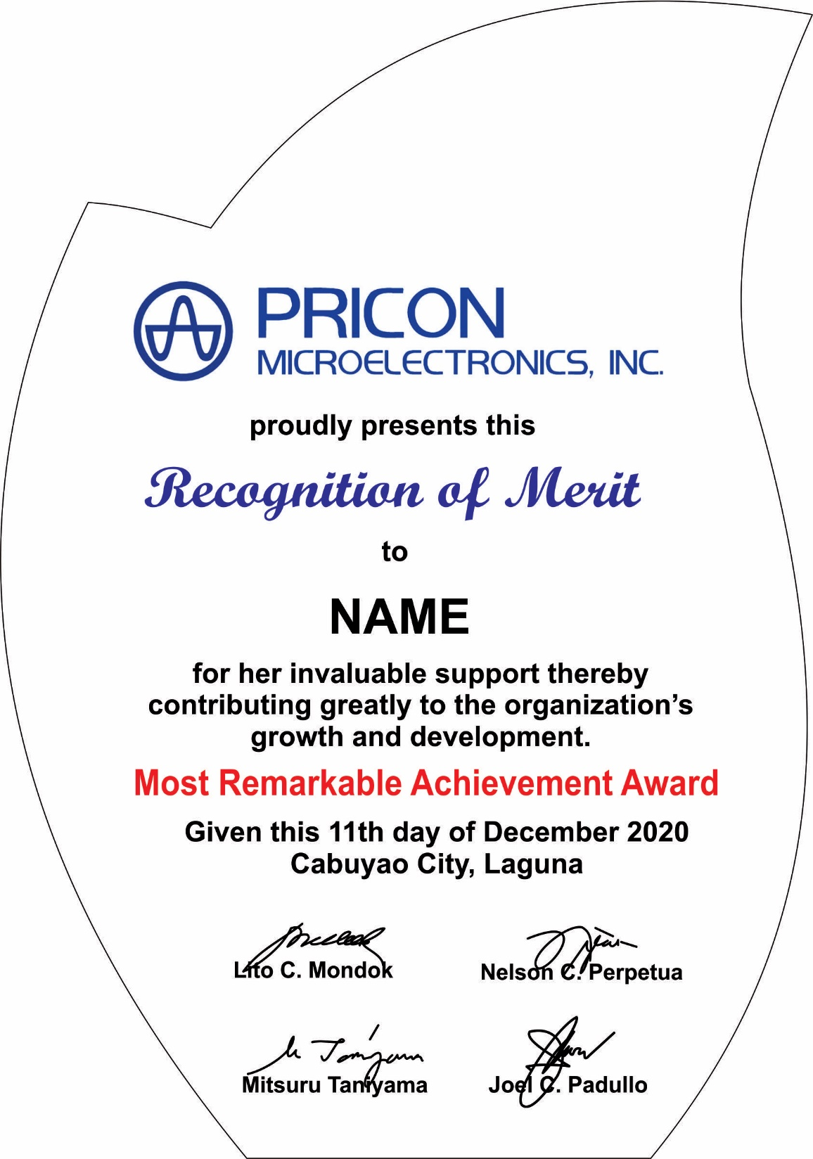
9th day of December 2022

Slide 2
Leadership Award
9th day of December 2022

Slide 3
Most Dynamic Award
9th day of December 2022

